Slide 1




Shandong Yuxiang Refrigeration Equipment Co., Ltd.
Global Business Plan
Presenter
Co-operator
Date
吴玉祥
项目总负责人
山东昱祥制冷设备有限公司
智慧矿山环境控制解决方案专家
July 20, 2026
China · Shandong
Notes:
尊敬的各位合作伙伴、投资人，大家下午好。欢迎参加山东昱祥制冷设备有限公司的全球化商业计划书发布会。今天，我将向各位详细阐述我们如何凭借领先的技术和创新的战略，抓住全球矿业发展的机遇，特别是聚焦中东市场，开启智慧矿山环境控制的新纪元。

Slide 2







Executive Summary: Key Findings & Strategic Recommendations
Enormous Market Opportunity
Global Market: $1.5B+ in 2026
Significant Competitive Advantages
Clear Strategic Path
The global mine ventilation & cooling market exceeds $1.5B in 2026, with surging investments in the Middle East driven by Vision 2030.
Specializing in deep mine cooling & intelligentization, forming technical barriers with outstanding cost-effectiveness & customization capabilities.
Adopt a "Dubai as hub, Saudi as core" strategy to focus resources on breaking key markets.
Innovative Growth Strategy Blueprint
Innovative Customer Acquisition Model
Sound Financial Projections
Core Goal
Integrate new media marketing & AI digital employees to build an efficient and precise customer acquisition system.
Profitability is expected in the third year, with a gradual increase in market share to over 1%.
Successfully establish a foothold in the Middle East and become a key player in the global mine environment control field.
Notes:
首先，让我们通过这份执行摘要快速了解我们计划的核心。我们发现，全球市场，特别是中东，正迎来前所未有的发展机遇。凭借我们显著的技术和成本优势，我们制定了清晰的“迪拜枢纽，沙特核心”战略。同时，我们将通过创新的新媒体和AI技术重塑获客模式。我们有信心在稳健的财务预期下，实现全球化发展的目标。

Slide 3
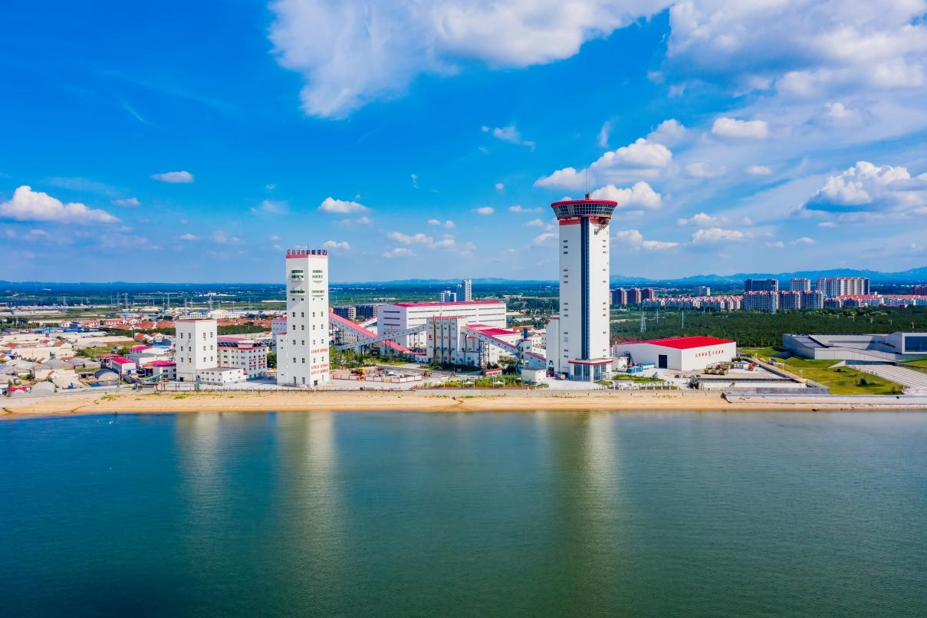
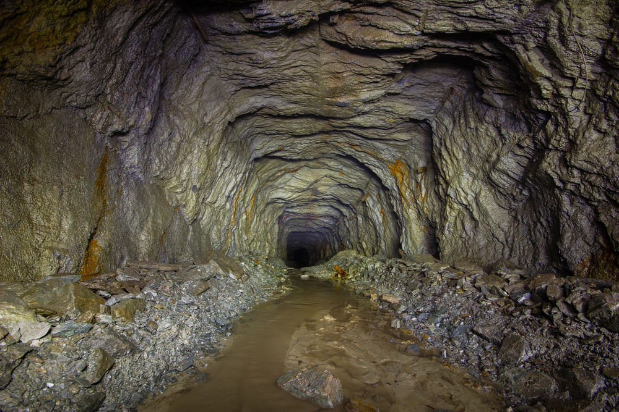
Leading Smart Mine Environment Control: Yuxiang's Innovative Practices
Core Positioning & Vision
Smart Mine Environment Expert
Based on technology and driven by innovation, we are committed to becoming a globally leading provider of mine environment solutions.
01 National High-Tech Enterprise
02 Full Range of Core Product Matrix
03 Technological Leadership & Full-Cycle Service
Established in 2019, we specialize in R&D, production, and service of underground mine environment control systems, with a professional R&D team and advanced production equipment.
Centered on the three core values of "Safety, Efficiency, Comfort", we provide mine-specific air conditioners, intelligent ventilation systems, and environmental monitoring & control systems.
We have made breakthroughs in ultra-deep mine geothermal control and AIoT intelligence, providing full-life-cycle services from solution design to operation and maintenance support.
Notes:
山东昱祥制冷成立于2019年，是一家专注于矿山井下环境控制的高新技术企业。我们的核心产品包括矿井特种空调、智能通风系统以及环境监测与智能控制系统。我们最大的优势在于技术领先，特别是在超深井地温控制和AIoT智能化方面取得了重大突破，并能为客户提供全生命周期的专业服务。

Slide 4
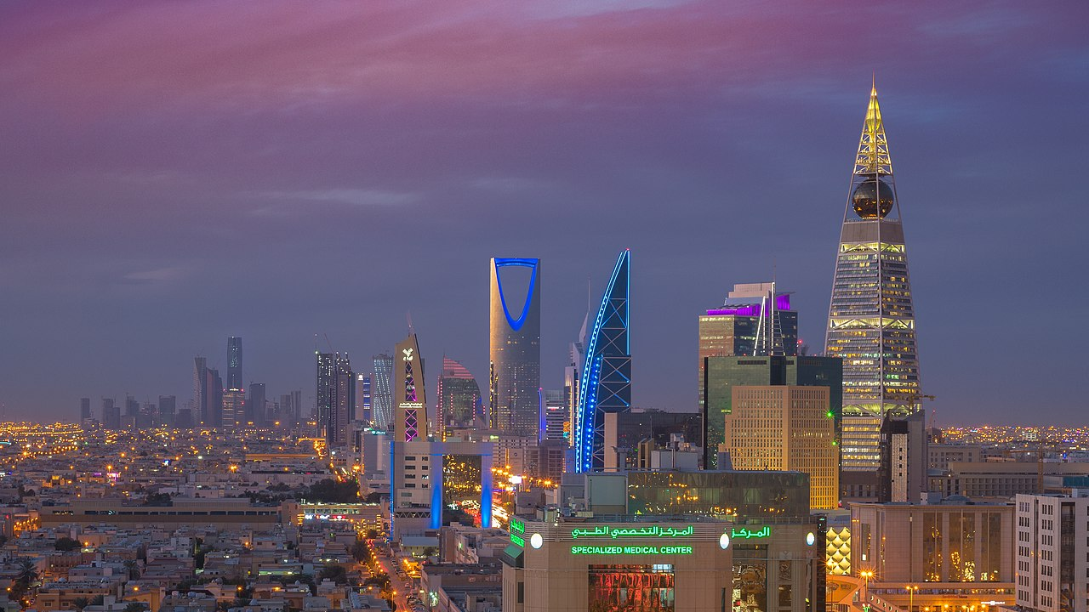





Global Market Overview: A Growing Blue Ocean
Driven by Market Scale and Growth Momentum
$100 Billion Market Expansion
High Compound Growth Engine
The global market size will reach$1.47 billionin 2026 and is expected to grow to$2.32 billionby 2034, offering vast market space.
The Compound Annual Growth Rate (CAGR) is as high as5.89%during the forecast period (2026-2034), indicating a stable upward trend for the industry.
Three Core Driving Forces
New Outlet for Automation
Stricter safety regulations, increasing mining depth, and the popularization of intelligent trends jointly drive sustained strong market demand.
Automated solutionsare the fastest-growing segment, highly aligned with our products, and our technological advantages will be transformed into market advantages.
全球矿业智能化发展示意图：展现了从传统开采向安全、智能、高效转型的行业未来趋势。
Strategic Opportunity to Seize the Global Blue Ocean MarketAgainst the backdrop of global economic recovery and the rapid development of the mining industry, the demand for mine environment control systems is showing a blowout growth. The automation and intelligent transformation of the mining industry is the general trend, and enterprises with core technological advantages will gain a broader market space. Seizing this opportunity will surely lead to brilliant development.
Notes:
放眼全球，我们看到一个巨大的蓝海市场。据权威机构预测，全球矿山通风市场在2026年将达到14.7亿美元，并以近6%的年复合增长率持续增长。这背后的驱动力包括日益严格的安全法规、不断增加的开采深度以及全球范围内的智能化趋势。特别是自动化解决方案，正是我们的核心优势所在。

Slide 5




In-depth Analysis of the Middle East Market: The Golden Window is Now
01 Saudi Vision 2030: A New Era for Mining Development
Economic Transformation: Mining Leaps to Become a Pillar of the Non-Oil Economy
Vigorously promoting economic diversification, mining is regarded as a strategic priority with planned investments exceeding hundreds of billions, ushering in explosive growth for the mining market.
$100 Billion Blue Ocean: High Market Scale and Growth Rate
The Saudi mining equipment market is expected to reach $7.32 billion in 2025, growing at a high CAGR of 5.83%, with demand for environmental control systems surging in tandem.
Policy Dividend: Accelerated Release of Mining Rights
The government strongly promotes mining development, accelerating the approval of mining rights, bringing a huge incremental market for mine environment control equipment.
Riyadh, Saudi Arabia — The Strategic Core Hub for Mining Investment and Economic Transformation in the Middle East
$7.32 Billion/ Market Size
Estimated total of Saudi mining equipment market in 2025, a direct market dividend from non-oil economic transformation, releasing huge growth space.
5.83% CAGR/ CAGR
The compound annual growth rate of the Middle East mining equipment market in the coming years, driven by continuous mining investment and capacity expansion.
Strategic Window: Intelligence Demand
As mining depth increases and safety standards rise, demand for efficient, intelligent environmental control systems is urgent, offering an excellent market entry point.
Notes:
Now, let's focus on the core of our plan—the Middle East market. Driven by Saudi Vision 2030, mining is becoming a key pillar of its economic transformation. The Saudi mining equipment market is huge and growing, meaning demand for our environmental control systems will grow at the same high rate. The market here is investment-driven, quality-focused, and highly dependent on local channels—this is where we can leverage our strengths.

Slide 6
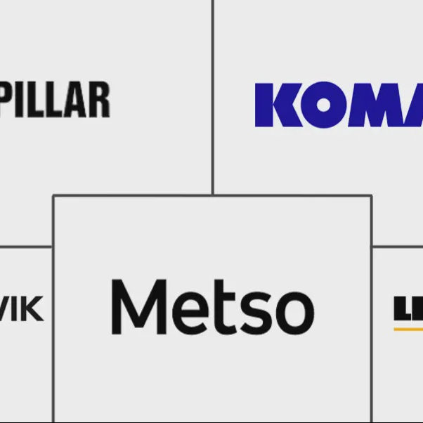


Competitive Analysis: How We Stand Out
International Giants: Strong Brands but Prominent Pain Points
Market Positioning: Focus on the Middle East, Full-Level Coverage
With the Middle East as the core strategic region, we focus on servinglarge mining groups and small and medium-sized mining enterprises, providing one-stop services from single equipment to overall solutions to meet the needs of customers at different levels.
Brands like Caterpillar and Sandvik have high brand awareness but suffer frominflexibility, high costs, and insufficient localized service depth, making it difficult to meet the customized needs of small and medium-sized mines.
Yuxiang's Advantages: Technical Differentiation + Ultimate Flexibility
Core Strategy: Technology as the Spear, Value as the Shield
Specializing in deep mine cooling and AIoT intelligence, we possess core technology patents, forming a unique competitive barrier; we also have significant cost advantages and fast-response customization capabilities.
Using leading technology and high-quality service as the entry point, we build a defensive barrier with highly competitive cost-effectiveness, accurately entering market gaps and creating irreplaceable core value.
Notes:
在竞争激烈的全球市场，我们如何脱颖而出？我们的主要竞争对手是像卡特彼勒、山特维克这样的国际巨头。他们虽然强大，但也存在灵活性不足、成本高昂等问题。而昱祥制冷的优势在于技术差异化、高性价比和强大的定制化能力。我们将聚焦中东市场，以技术和服务为核心，精准切入市场。

Slide 7


Market Entry Strategy: Dubai as the Hub, Saudi Arabia as the Core
Core Strategy: Regional Headquarters for Overall Planning, Local Distribution for Penetration
Adopt the "Regional Headquarters + Local Distribution" model, with Dubai as the strategic planning center radiating the entire Middle East market; take Saudi Arabia as the core target market, achieving rapid penetration and in-depth coverage through a localized distribution network.
Phase 1: Establish Regional Headquarters in Dubai
Phase 2: Develop Local Distribution in Saudi Arabia
Strategic Function:Register a company in the Dubai Free Trade Zone to enjoy tax incentives and free trade policies. As the regional strategic center, it is responsible for market planning, sales management, logistics warehousing, and after-sales service, radiating neighboring countries.
Cooperation Selection:Seek cooperation with local companies that have deep customer relationships and market networks in the Saudi mining sector. Provide product training, market support, and technical services to jointly explore the market and achieve mutual benefit and win-win results.
Deeply integrate into the local market, use Dubai's advantages to connect global resources, transform the advantages of local distributors into market advantages, and achieve high-quality and sustainable growth.
Notes:
我们的市场进入策略非常清晰：“迪拜为枢纽，沙特为核心”。我们将分两步走：首先，在迪拜设立区域总部，利用其作为国际金融和贸易中心的优势，统筹整个中东市场的战略。然后，在沙特，我们将发展强大的本地分销商，借助他们的网络和关系，快速实现市场渗透。

Slide 8



Innovative Customer Acquisition Path: New Media Marketing Matrix
Build a multi-channel, three-dimensional new media matrix to accurately reach core decision-makers in the Middle East mining industry and efficiently convert potential business opportunities.
01 LinkedIn Professional Marketing
02 Multilingual Official Website & SEO Layout
03 Online Exhibitions & Live Streaming Interaction
Publish high-quality technical articles, product cases, and industry insights, accurately target professionals such as mining engineers and procurement managers, build a professional brand image, and acquire high-quality sales leads.
Build multilingual official websites in English and Arabic, optimize localized content and SEO layout for the Middle East market, improve rankings on search engines such as Google, and acquire precise organic traffic.
Actively participate in top international exhibitions in the Middle East such as GITEX, host online product live streams and technical seminars, interact with potential customers in real-time, visually demonstrate product performance and technical strength, and enhance brand awareness.
This new media marketing strategy can effectively enhance the company's brand influence in the Middle East market, transform technical advantages into market recognition, and provide a steady stream of high-quality leads for sales. It is an important part of the company's internationalization strategy and will help the company gain a firm foothold in the fierce market competition.
Notes:
To efficiently acquire customers, we will build a strong new media marketing matrix. First, we will conduct professional marketing on LinkedIn to accurately reach target customers. Second, we will establish multilingual official websites and optimize SEO so that customers can easily find us. Finally, we will actively participate in online exhibitions and host product live streams to interact directly with customers and demonstrate our technical strength.

Slide 9




Innovative Customer Acquisition Path: Empowering Sales with AI Digital Employees
AI-Driven: Full-Process Intelligent Efficiency Improvement
Restructure the traditional sales model, liberate human resources from tedious screening and follow-up, focus on in-depth mining and conversion of high-value customers, and achieve comprehensive intelligence and automation of the sales process.
01 AI Lead Intelligence Screening: Accurately Lock High-Potential Customers
Automatically integrate multi-channel leads, perform cleaning, deduplication, and intent scoring through AI algorithms, quickly identify high-value customers, and greatly improve lead screening efficiency.
AI Digital Employees: The Engine Reshaping Sales Productivity
All-Weather Intelligent Collaboration Partner
Working 7x24 hours without interruption, automatically processing massive leads, liberating sales from repetitive work, focusing on customer relationship building and business negotiations, and realizing an efficient sales model of human-machine collaboration.
02 Automated Cultivation: Activate Medium and Low-Intent Leads
Automatically send personalized emails, SMS, and WhatsApp messages through AI, regularly push industry news and product information, continuously cultivate customers, and improve lead conversion rates.
03 Process Automation: Intelligent Assistance and Empowerment
Automatically generate customer visit reports and meeting minutes, provide sales with follow-up suggestions, and offer real-time technical support and negotiation strategies during communication to enhance sales professionalism and efficiency.
🎯 Key Results: Significant Cost Reduction and Efficiency Improvement
Deploying AI digital employees can increase lead screening efficiency by more than 30%, lead reach rate by more than 10%, and ultimately increase sales conversion rate by 15-20%, achieving scalable growth of the sales team.
Notes:
更令人兴奋的是，我们将部署AI数字员工来赋能销售。它能帮助我们智能筛选线索、自动化培育客户，并辅助销售完成日常工作。这不仅能将销售团队从繁琐的事务中解放出来，专注于高价值客户，更能将整体销售转化率提升15%到20%，实现真正的智慧销售。

Slide 10



Breakdown of Initial Investment Budget for the First Year
Basic Administration & Facility Setup
Localized Core Team Building
Invest 300,000 RMB to cover company registration, legal and administrative services, as well as basic operating expenses such as office space rental and equipment procurement to ensure rapid business launch.
Invest 800,000 RMB to recruit regional managers, sales, and technical support personnel, forming a localized team familiar with the local market and possessing professional capabilities to provide talent guarantee for market expansion.
Omni-Channel Marketing Launch
Inventory Stock & Risk Guarantee
Invest 500,000 RMB to participate in international exhibitions, online advertising, content creation, and public relations activities to quickly enhance brand awareness and influence in the Middle East market.
Invest 1,000,000 RMB for the first batch of product stock to ensure timely response to customer orders; reserve 400,000 RMB as a risk reserve to deal with market uncertainties and ensure the steady progress of the project.
Estimated Cost of Traditional Self-Operation
> 4,000,000 RMB(Including trial and error, labor, and hidden costs)
Exclusive Program Investment with Dailu
3,000,000 RMB(One-stop full package, no additional hidden fees)
Conclusion: 3 million RMB can fully cover the core layout in the Middle East market, strictly control costs and risks, and provide a solid financial guarantee for opening up the market!
Notes:
接下来是大家关心的投入问题。我们估算，第一年的初始总投入约为300万人民币。这笔费用将主要用于公司注册、办公设施、团队组建、市场营销以及首批产品库存。我们还预留了40万元的预备金，以应对可能出现的风险。这是一个经过审慎评估的、合理的启动预算。相比传统的自主出海模式，这笔预算不仅更具针对性，还能有效规避因经验不足带来的额外试错成本，确保每一分资金都用在刀刃上，为项目在中东的顺利启动提供强有力的资金支持。

Slide 11
Market Share & Revenue Forecast
Steady Growth Path: Blueprint for Profitability in Three Years and Long-Term Expansion in the Middle East Market
2026 (Year 1): Initial Market Penetration
Aim to acquire 0.2% of the Middle East market share, achieve sales revenue of $200,000, and complete the initial brand layout and channel construction.
2030 (Year 5): Deepen Industry Leadership
Market share reaches 1.5%, annual revenue exceeds $1.5 million, becoming an important player in the Middle East mine environment control field with industry influence.
2027 (Year 2): Steady Scale Expansion
Market share increases to 0.5%, sales revenue grows to $500,000, optimize channel management, and enhance brand awareness.
Intelligent Growth: Value Realization Driven by Data
Based on accurate market data analysis and customer demand insights, formulate scientific sales strategies and resource allocation plans to ensure that every step of growth is supported by data and achieve sustainable value growth.
2028 (Year 3): Achieve Profitability Inflection Point
Market share reaches 0.8%, achieving annual profitability with sales revenue of $800,000, establishing a stable customer base and market position.
Long-Term Vision: Create a New Benchmark for the Middle East Mine Environment
Committed to becoming the most trusted mine environment solution service provider in the Middle East, promoting industry progress and achieving common growth with customers through continuous technological innovation and high-quality services.
Notes:
We are confident in our future growth. Our goal is to capture 0.2% of the Middle East market share and achieve $200,000 in revenue in the first year. By the third year, we expect to reach profitability with annual revenue of $800,000. By the fifth year, our target is to increase market share to 1.5% and exceed $1.5 million in annual revenue. This is a steady and achievable growth path.

Slide 12





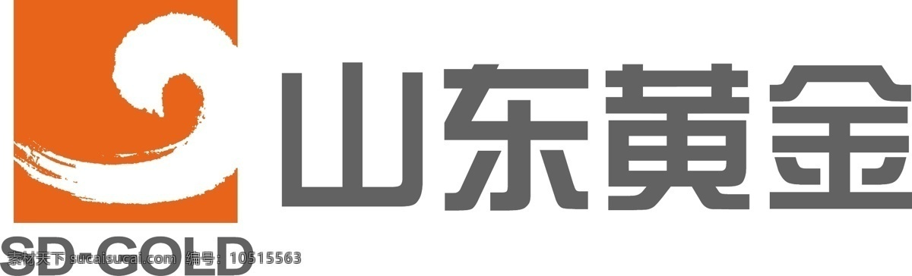
Risk Assessment & Response Strategies
01 Market Competition Risk
International giants have obvious brand advantages and fierce price competition. Response: Strengthen technological differentiation, highlight intelligent and customized advantages, and provide more competitive cost-effectiveness and localized services.
04 Technology Adaptation & Product Risks
Products may not be fully adapted to the local extreme environment or technical failures may occur. Response: Conduct sufficient local environment tests; establish a fast-response localized technical support and after-sales service system.
02 Geopolitical & Policy Risks
The political situation in the Middle East may affect the business environment and project investment. Response: Closely monitor local political dynamics, reduce risks through means such as purchasing insurance; share risks with local partners.
05 Supply Chain & Compliance Risks
Cross-border logistics delays and local compliance barriers. Response: Optimize customs clearance via free trade ports, complete local certification in advance, and establish regional overseas warehouses for buffering.
03 Cultural Differences & Communication Risks
Cultural differences and language barriers may affect business negotiations and cooperation. Response: Form a localized team, strengthen cross-cultural training, and respect local business customs and religious practices.
Core Risk Control: Build a "Localization + Technology + Partners" Triple Firewall
Risk control is key to overseas success. Root in the market via localized teams, build moats with technological differentiation, and share risks with local partners to turn uncertainties into manageable variables for long-term stability.
Notes:
当然，任何商业计划都伴随着风险。我们已经识别了市场竞争、地缘政治、文化沟通和技术产品这四类主要风险。针对每一种风险，我们都制定了详细的应对策略。例如，面对市场竞争，我们将强化技术差异化；面对地缘政治风险，我们将与本地伙伴共担风险。我们有信心管理好这些潜在挑战。

Slide 13
Summary of Core Business Value & Market Potential Data
A panoramic presentation of key indicators for market size, growth trends, and return on investment.
01 / Global & Middle East Market Size and Growth Rate
02 / Digital Empowerment & ROI Expectations
The global mine ventilation market will reach $1.47 billion in 2026 with a CAGR of 5.89%; the Saudi mining equipment market will reach $7.32 billion in 2025 with a CAGR of 5.83%. As a core segment, the environmental control system market has huge potential and high growth certainty.
Digital empowerment significantly improves sales efficiency, and AI digital employees can increase the sales conversion rate by 15-20%. With an initial investment of 3 million RMB, profitability is expected in the third year, with a high return on investment.
These core data fully demonstrate the broad market prospects and strong growth potential of the project. From the huge market scale at the global and regional levels, to the efficiency improvement brought by digital transformation, and then to the clear investment return expectations, all indicate that this is aproject with high potential and worthy of investment. Seizing the opportunity in the Middle East market will surely achieve considerable economic benefits and strategic value.
Notes:
这张幻灯片汇总了我们计划中的一些核心数据。从全球和沙特的市场规模及增长率，到AI数字员工带来的效率提升，再到我们的初始投入和盈利目标。这些数据共同描绘了一幅清晰、可靠的商业蓝图。

Slide 14
Conclusion: Reshaping Mine Operation Standards with Technology
"Improve miners' working environment and increase their efficiency"
— This is not just a slogan, but a solemn commitment to the value and dignity of workers.
From the scorching heat of 46°C in Sanshandao Gold Mine to the cool constant temperature of 28°C, we have reshaped the standards of mine operations with technology. This is not only about cooling the environment, but also about improving the quality of life for every miner.
The mines in the Middle East also desire such changes. Shandong Yuxiang is willing to be a solid bridge connectingChinese technology with Middle Eastern needs, bringing this wisdom of improving the environment and creating value to every underground mine, and letting the light of technology cross mountains and seas to light up a new future for industrial upgrading.
Notes:
Finally, I want to say that the core goal of everything we do is to "Improve miners' working environment and increase their efficiency". This is not just a slogan, but our mission. We have proven our technical strength in China, and now we hope to bring this capability to the Middle East, reshape mine operation standards with technology, and contribute our wisdom and strength to the local industrial upgrading.

Slide 15

The wind has risen, the ship is ready.
Looking forward to working with you to create the future.
Shandong Yuxiang Refrigeration Hong Hanqiu
Tel：18676577313 | Email：ceo@yuxiangrefrigeration.com
Notes:
风已起，船已备。山东昱祥制冷已经准备好迎接全球化的挑战。我们诚挚地邀请各位合作伙伴和投资人，与我们携手，共同抓住这个历史性的机遇，共创辉煌的未来。谢谢大家！

